Slide 1
CAR PARKING SYSTEM
Project By : Avnish Kumar (2508101530017, Ayush Aggarwal 2508101530018
Kuldeep Singh 2508101530034,
Akash Dubey 2508101530007
Course : B.Tech CSE (AIML)
College : Greater Noida College

Slide 2
Introduction
A Car Parking System is a simple menu-driven application developed in C programming. It helps manage parking spaces by allowing users to park cars, remove cars, and check the current parking status.
Purpose
Manage parking spaces efficiently.
Keep track of parked vehicles.
Display available parking spaces.
Reduce manual parking management.

Slide 3
Project Objectives
To develop a menu-driven parking management system.
To keep track of occupied parking spaces.
To display available parking spaces.
To prevent parking beyond the maximum capacity.
To improve understanding of C programming concepts.

Slide 4
Features
Park a Car.
Remove a Car.
Display Parking Status.
Exit the Program.
Handles Invalid Menu Choices.
Simple and User-Friendly

Slide 5
Algorithm
Start the program.
Enter the total number of parking spaces.
Display the menu.
Read the user's choice.
If the user selects:
1: Park a car.
2: Remove a car.
3: Display parking status.
4: Exit the program.
Repeat the menu until the user chooses Exit.
End the program.

Slide 6

Code Explanation
Main Variables
Variable | Purpose
totalSpace | Stores the total number of parking spaces.
occupied | Keeps track of the number of parked cars.
choice | Stores the user's selected menu option.

Slide 7
Key Programming Concepts
while(1) → Displays the menu repeatedly.
switch-case → Handles the user's menu selection.
if-else → Checks parking availability.
occupied++ → Increases the number of parked cars.
occupied-- → Decreases the number of parked cars.

Slide 8
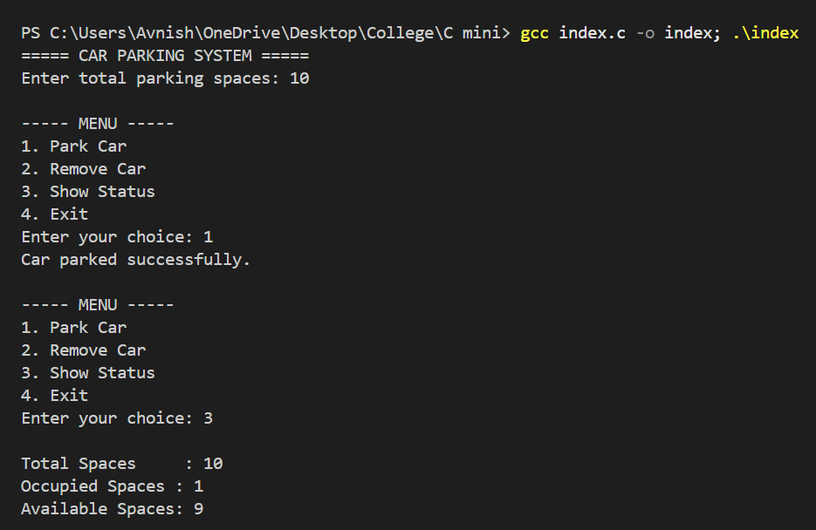
Sample Output

Slide 9
Advantages
Easy to understand and use.
Efficient parking space management.
Prevents over-parking.
Helps beginners learn C programming concepts.
Can be expanded into a real-world parking system.

Slide 10
Conclusion
The Car Parking System successfully manages parking spaces using a simple menu-driven approach in C. It demonstrates the practical use of variables, loops, conditional statements, and switch-case. The project provides a strong foundation for learning basic programming.
Thank You

